Slide 1
ON ONE SOLUTION OF THE PROBLEM OF STOCHASTIC LONGITUDINAL OSCILLATIONS OF A VISCOELASTIC ROPE WITH MOVING BOUNDARIES USING ARTIFICIAL INTELLIGENCE AND MACHINE LEARNING METHODS
Vladislav L. Litvinov
Samara State Technical University
MathAI 2025

Slide 2
Relevance of the topic
Systems, the boundaries of which are moving, are widespread in technology (ropes of hoisting installations [1–5, 7, 8], flexible transmission links [6], etc.). The presence of moving boundaries causes significant difficulties in describing such systems.
The solution is implemented in dimensionless variables using the TB–Analysis software package developed in the Matlab, Python environment, which allows using the obtained results to calculate a wide range of technical objects. The TB–Analysis software package contains a module – resonance phenomena management. The "Resonance phenomena management" command is designed to determine the resonance region and identify resonance prevention conditions imposed on the model parameters using AI.
In addition, it is recognized that deterministic modeling of systems cannot be adequate for some types of problems, so it is necessary to move on to probabilistic–statistical, where random variables and stochastic oscillations are present.
Using artificial intelligence, the resonant frequencies of the system, as well as the conditions under which resonance can be prevented, were determined. The optimization of the system parameters under which the probability of resonance is minimal was carried out. Data was collected – amplitude–frequency characteristics of the system. Key parameters that affect resonance were determined. A neural network was trained on the data. In this case, the network predicts resonant frequencies and suggests optimal parameters. Nonlinear regression methods were used to determine the resonance conditions. In case of insufficient data, the data synthesis method – the Monte Carlo method – was used. ML methods were used to analyze which system parameters have the greatest influence on resonance. Clustering algorithms (k–means) were used to group frequencies at which the system is most vulnerable. Graphs of amplitude–frequency characteristics were constructed to clearly identify resonant areas. To prevent resonance, optimization of parameters was carried out using the gradient descent method to adjust system parameters, such as increasing damping and changing rigidity. Adaptive control methods and neural networks were used for dynamic adjustment of the system in real time.
The results of the AI work are tested on a mathematical model. Calculations confirmed that the proposed parameters really prevent resonance. This paper proposes an approach based on the application of artificial intelligence (AI) and machine learning (ML) methods, which not only improves the accuracy of calculations but also significantly reduces the time required to find optimal system parameters.

Slide 3
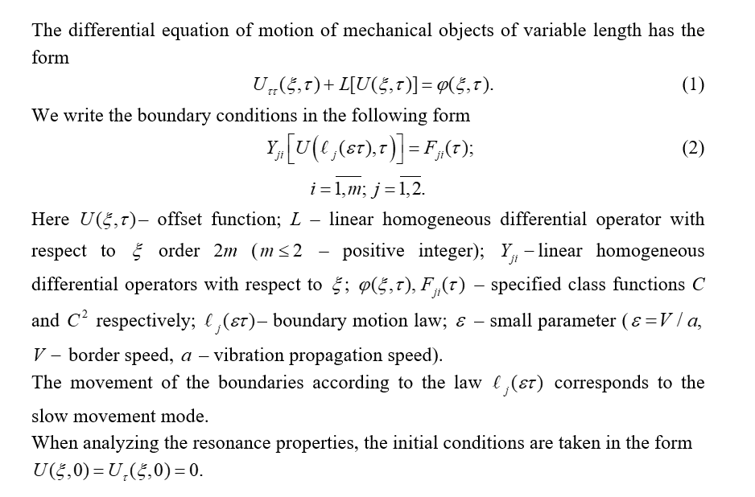
MATHEMATICAL STATEMENT OF THE PROBLEM (1)

Slide 4
MATHEMATICAL STATEMENT OF THE PROBLEM (2)
Problem
Boundary conditions
Solution
Integro-differential equation of motion
We seek the solution to problem (19) in the form of a series:

Slide 5
MATHEMATICAL STATEMENT OF THE PROBLEM (3)
Own functions
Решение
Let us expand the symmetric kernel into a series of eigenfunctions
System of ordinary with variable coefficients (order accuracy )

Slide 6
MATHEMATICAL STATEMENT OF THE PROBLEM (4)
Solution to problem (14) - (15)
If we introduce a new function into (26)
then the system of d.e. (26) will not contain a memberс
Expression for the amplitude of oscillations at

Slide 7
Methodology of analysis and numerical study of resonance properties
The expression for the amplitude of the system's oscillations in the n-th dynamic mode is:
The phenomenon of steady-state resonance will be observed if the rate of change of the function
equals zero, i.e. where constant value. In this case, the increase in amplitude is described by the following expression:
The phenomenon of passing through resonance is observed in the time domain containing the point
, where If we take the amplitude at the beginning of the resonant region (point )
to be equal to the amplitude of the external influence, then the amplitude at the end of the resonant region (point ) is determined by the expression:

Slide 8
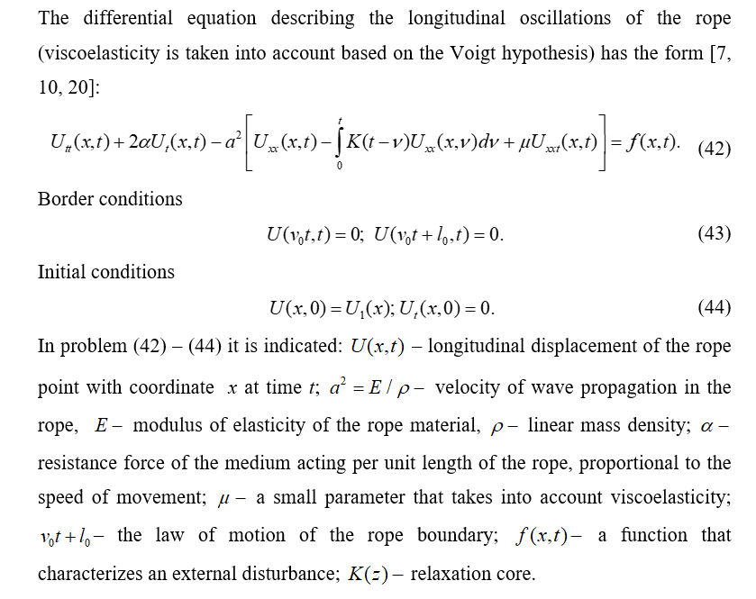
STOCHASTIC OSCILLATIONS OF THE ROPE
WITH MOVING BOUNDARIES (1)

Slide 9
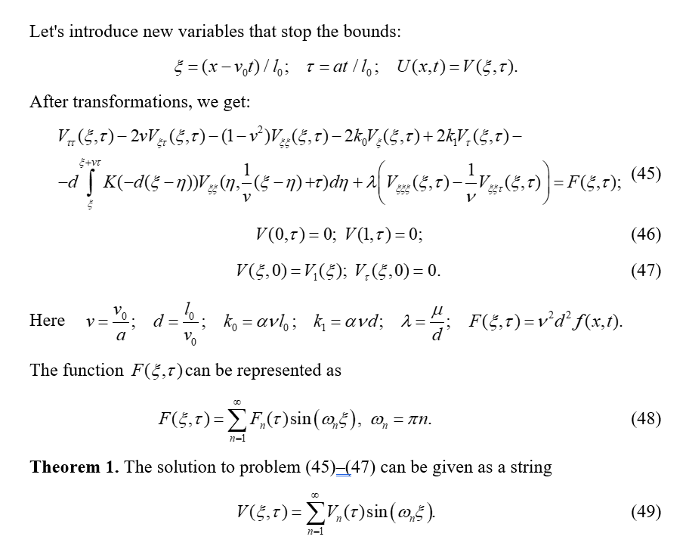
STOCHASTIC OSCILLATIONS OF THE ROPE
WITH MOVING BOUNDARIES (2)

Slide 10
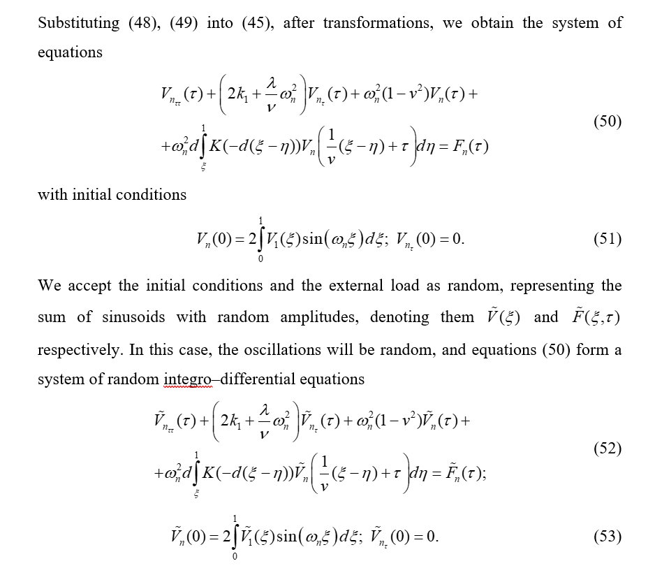
STOCHASTIC OSCILLATIONS OF THE ROPE
WITH MOVING BOUNDARIES (3)

Slide 11
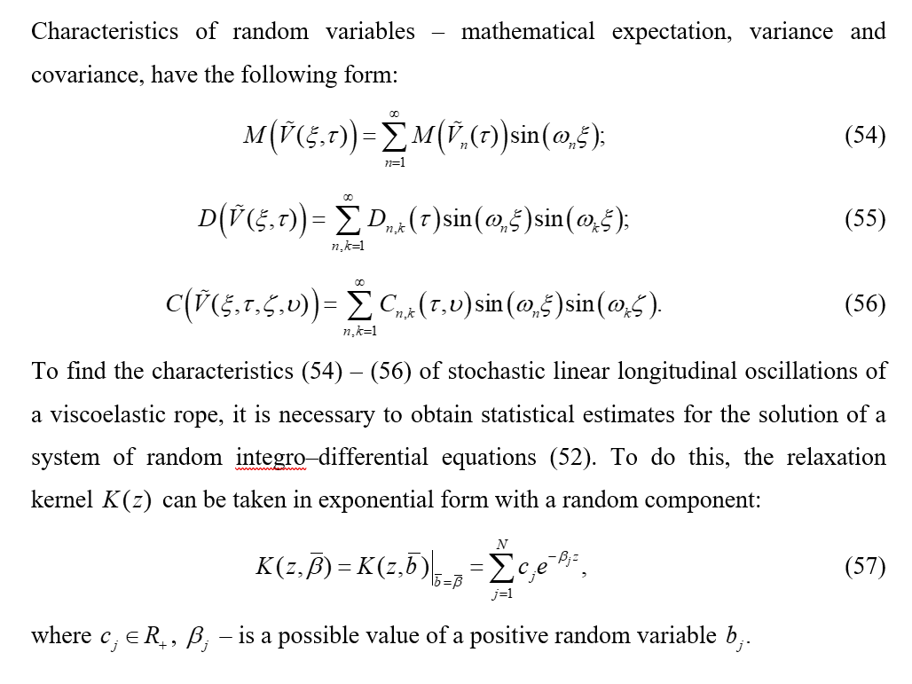
STOCHASTIC OSCILLATIONS OF THE ROPE
WITH MOVING BOUNDARIES (4)

Slide 12
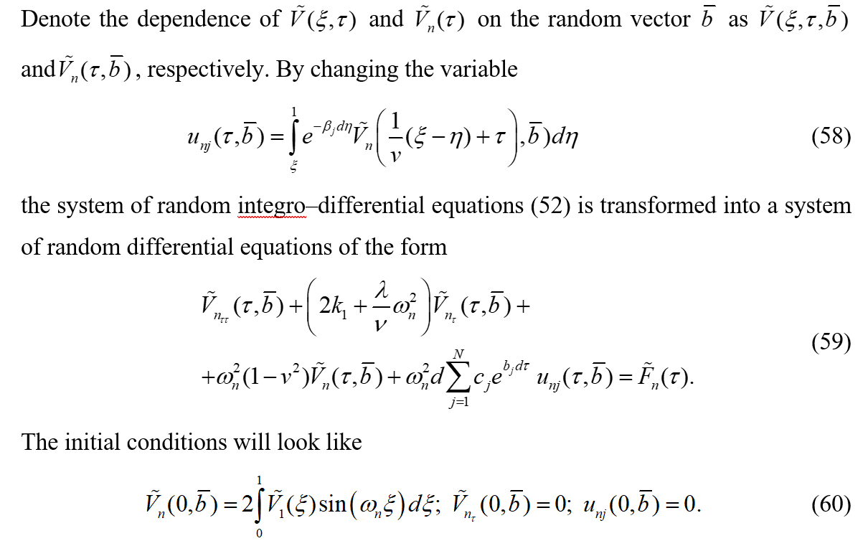
STOCHASTIC OSCILLATIONS OF THE ROPE
WITH MOVING BOUNDARIES (5)

Slide 13
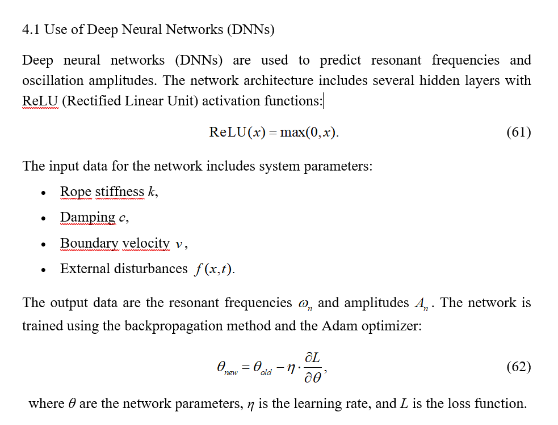
APPLICATION OF ARTIFICIAL INTELLIGENCE AND MACHINE LEARNING (1)

Slide 14
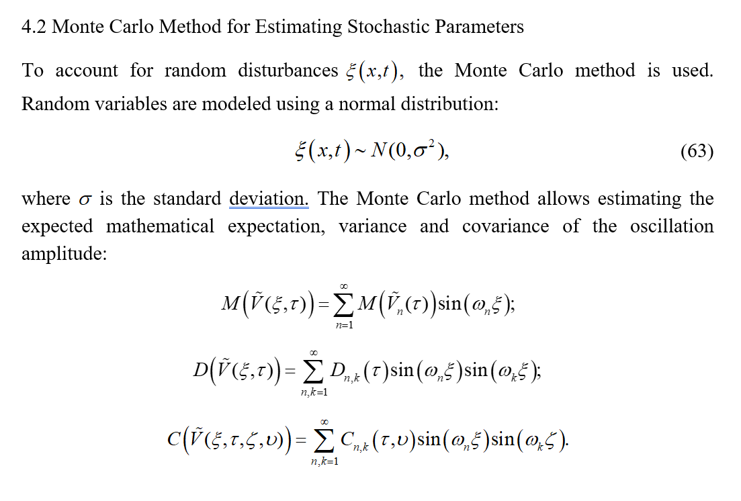
APPLICATION OF ARTIFICIAL INTELLIGENCE AND MACHINE LEARNING (2)

Slide 15
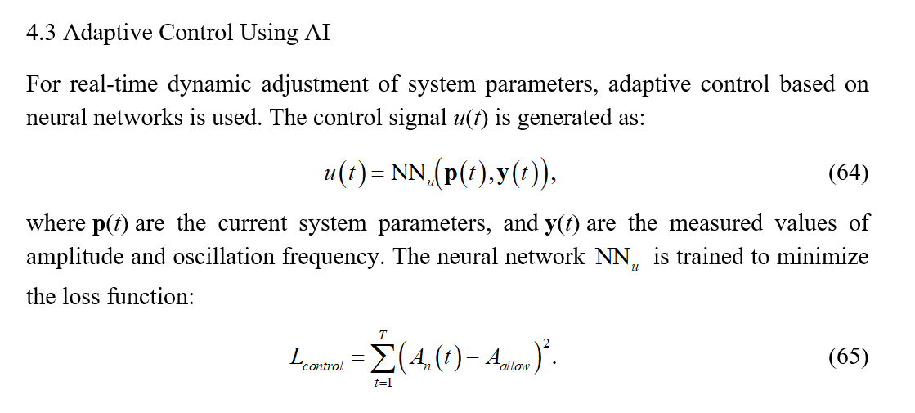
APPLICATION OF ARTIFICIAL INTELLIGENCE AND MACHINE LEARNING (3)

Slide 16
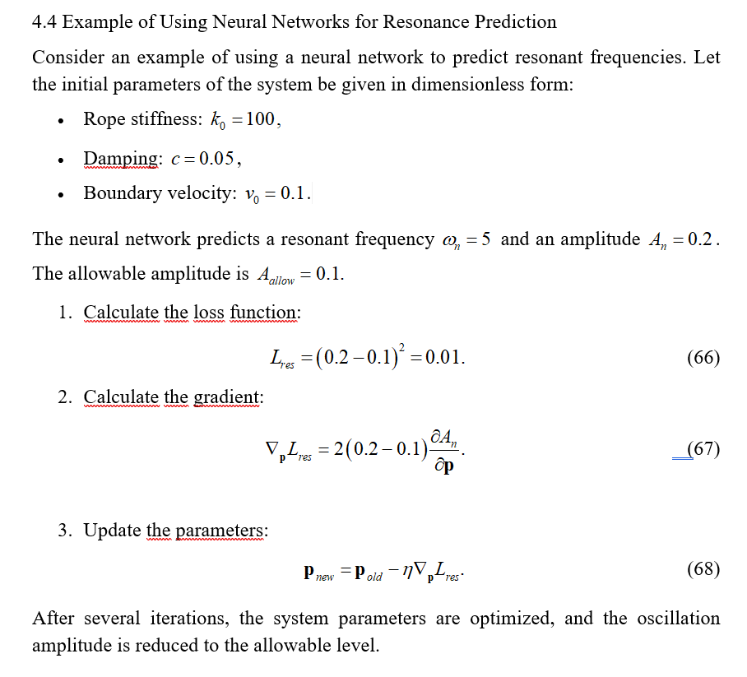
APPLICATION OF ARTIFICIAL INTELLIGENCE AND MACHINE LEARNING (4)

Slide 17
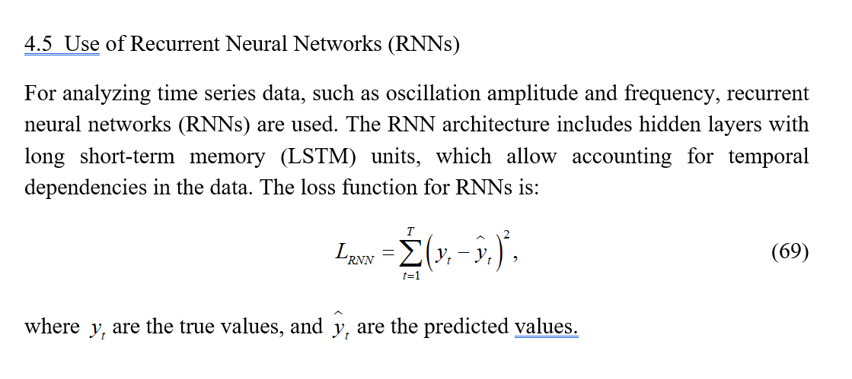
APPLICATION OF ARTIFICIAL INTELLIGENCE AND MACHINE LEARNING (5)

Slide 18
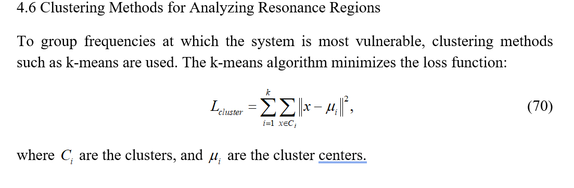
APPLICATION OF ARTIFICIAL INTELLIGENCE AND MACHINE LEARNING (6)

Slide 19
SOFTWARE PACKAGE TB–ANALYSIS
The developed software package "TB–Analysis" is designed to solve a certain class of one–dimensional boundary value problems with moving boundaries, as well as for mathematical modeling and analysis of the resonant properties of objects whose states are described by these boundary value problems. The software package also allows for the selection of model parameters to prevent resonance phenomena using artificial intelligence (AI). The software was developed in the Matlab, Python environment environment as a standalone application.
The user interface of the "TB–Analysis" software package consists of four windows, one of which is the startup window. This window appears when the program is launched, and the other windows can be accessed from the startup window. Additionally, these windows can be accessed from one another via a menu. The startup window of "TB–Analysis" contains three active buttons with schematic illustrations, which launch the following main modules of the software package:
1.Investigation of solutions to model boundary value problems;
2.Analysis of resonant properties of models;
3. Management of resonance phenomena.

Slide 20
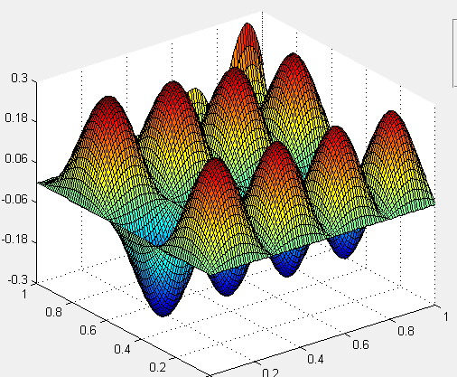
An example of the module's operation
Fig. 1. Graph of the solution function for a boundary value problem
of transverse vibrations of a cable.

Slide 21
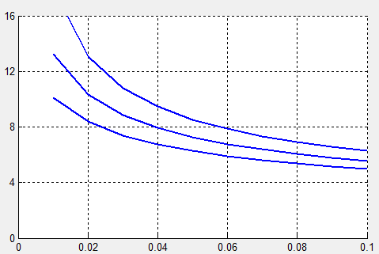
An example of the module's operation
Fig. 2. Graph of the dependence of the maximum amplitude on the speed of boundary
movement for various values of the environmental resistance coefficient.

Slide 22
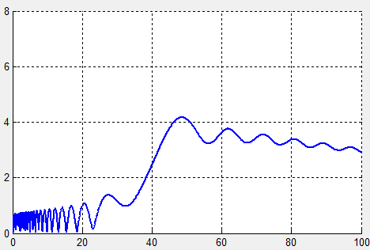
An example of the module's operation
Fig. 3. Graph of the dependence of amplitude on time.

Slide 23
CONCLUSION
Thus, with the help of the software package “TB–Analysis” artificial intelligence was utilized to identify the resonant frequencies of the system and the conditions under which resonance could be avoided. The system's parameters were optimized to reduce the probability of resonance. Data on the system's amplitude–frequency characteristics were collected, and key parameters affecting resonance were determined. A neural network was trained on this data to predict resonant frequencies and amplitudes. Nonlinear regression methods were applied to define resonance conditions, and the Monte Carlo method was used for data synthesis when data was insufficient. Machine learning techniques were employed to analyze which system parameters most significantly influence resonance. Frequency analysis using the Fast Fourier Transform (FFT) was conducted to identify resonance regions, and clustering algorithms (k–means) were used to group frequencies where the system is most vulnerable. Amplitude–frequency characteristic graphs were plotted to clearly delineate resonance areas. To mitigate resonance, system parameters such as damping and stiffness were optimized using gradient descent. Adaptive control methods and neural networks were implemented for real–time system tuning. AI was also used to forecast conditions that could lead to resonance and to prevent it.
The problem of stochastic longitudinal vibrations in a viscoelastic cable with moving boundaries, considering damping forces, was formulated as a system of stochastic integro–differential equations. This system was simplified to a set of stochastic differential equations with random initial conditions. The Monte Carlo method was proposed for estimating expansion coefficients. The neural network was trained on data reflecting the system's behavior across various frequencies and parameters, enabling it to predict resonant frequencies and recommend optimal parameters. The AI's predictions were validated using a mathematical model, confirming that the suggested parameters effectively prevent resonance.
The use of deep neural networks, Monte Carlo methods and adaptive control not only improves the accuracy of forecasting, but also significantly reduces the time required to find the optimal system parameters.

Slide 24
REFERENCES
1.Kolosov L.B., Zhigula T.I. Longitudinal–transverse vibrations of the rope of the lifting installation // Izv. Universities. Mining Journal. 1981. No. 3. P. 83–86.
2.Zhu W.D., Chen Y. Theoretical and experimental investigation of elevator cable dynamics and control // J. Vibr. Acoust. 2006. No. 1. P. 66–78.
3.Shi Y., Wu L., Wang Y. Nonlinear analysis of natural frequencies of a tether system // J. Vibr. Eng. 2006. No. 2. P.173–178.
4.Wang L., Zhao Y. Multiple internal resonances and non–planar dynamics of shallow suspended cables to the harmonic excitations // J. Sound Vib. 2009. No. 1–2. P. 1–14.
5.Zhao Y., Wang L. On the symmetric modal interaction of the suspended cable: three–to one internal resonance // J. Sound Vib. 2006. No. 4–5. P.1073–1093.
6.Vesnitsky A.I. Waves in systems with moving boundaries and loads. Moscow: Fizmatlit, 2001. 320 p.
7.Goroshko O.A., Savin G.N. Introduction to the mechanics of deformable one–dimensional bodies of variable length. Kiev: Nauk. dumka, 1971. 290 p.
8.Litvinov V.L., Anisimov V.N. Transverse vibrations of a rope moving in a longitudinal direction // Bulletin of the Samara Scientific Center of the Russian Academy of Sciences. 2017. T. 19.No. 4. – P.161–165.
9.Litvinov V.L., Anisimov V.N. Mathematical modeling and research of oscillations of one–dimensional mechanical systems with moving boundaries: monograph / V. L. Litvinov, V. N. Anisimov – Samara: Samar. state tech. un–t, 2017 .– 149 p.
10.Lezhneva A.A. Free bending vibrations of a beam of variable length // Uchenye zapiski. Perm: Perm. un–t, 1966. No. 156. P. 143–150.
11.Savin G.N., Goroshko O.A. Variable length thread dynamics. Kiev: Nauk. Dumka, 1962. 332 p.
12.Litvinov V.L. Investigation of free vibrations of mechanical objects with moving boundaries using the asymptotic method // Zh. Middle Volga Mathematical Society. 2014. T. 16.No. 1. P.83–88.
13.Liu Z., Chen G. Analysis of Plane Nonlinear Free Vibrations of a Carrying Rope Taking into Account the Influence of Flexural Rigidity // J. Vibr. Eng. 2007. No. 1. P. 57–60.
14.Litvinov V.L., Anisimov V.N. Application of the Kantorovich – Galerkin method for solving boundary value problems with conditions on moving boundaries // Bulletin of the Russian Academy of Sciences. Rigid Body Mechanics. 2018. No. 2. P. 70–77.
15.Litvinov V.L., Anisimov V.N. Transverse vibrations of a rope moving in a longitudinal direction // Bulletin of the Samara Scientific Center of the Russian Academy of Sciences. 2017. T. 19. No. 4. – P.161–165.
16.Litvinov V.L., Anisimov V.N. Mathematical modeling and research of oscillations of one –dimensional mechanical systems with moving boundaries: monograph / V. L. Litvinov, V. N. Anisimov – Samara: Samar. state tech. un–t, 2017 .– 149 p.
17.Elepov B. S., Kronberg A. A., Mikhailov G. A. and Sabelfeld K. K. Solution of boundary value problems by the Monte Carlo method. – Novosibirsk: Nauka, 1980. – 174 p.
18.Ermakov S. M. Monte Carlo Method in Computational Mathematics: An Introductory Course. – St. Petersburg: Nevsky Dialect; M.: BINOM. Knowledge Laboratory, 2009. – 192 pp.
19.Fishman G. S. Monte Carlo. Concepts, Algorithms, and Applications. — SpringerVerlag, 1995 (Corrected 3 rd printing, 1999). — 718 pp.
20.Litvinov V.L. Stochastic longitudinal oscillations of a viscoelastic rope with moving boundaries taking into account the action of damping forces // Probability Theory and Its Applications, RAS, 2022, Vol. 67, No. 4, pp. 835–836.
21.Litvinov V.L. Solution of boundary value problems with moving boundaries using an approximate method for constructing solutions of integro–differential equations // Tr. Institute of Mathematics and Mechanics, Ural Branch of the Russian Academy of Sciences. 2020.Vol. 26, №. 2. P. 188–199.
22.Litvinov V.L., Litvinova K.V. An approximate method for solving boundary value problems with moving boundaries by reduction to integro–differential equations// Computational Mathematics and Mathematical Physics, 2022, vol. 62, no. 6, pp. 945–954.
23.Litvinov V.L. Certificate of state registration of a computer program. Automated software package for studying oscillations and resonance phenomena in mechanical systems with moving boundaries "TB-Analysis-7" No. 2025613649, published 13.02.2025.

Slide 25
Thank you!

